Slide 1

单击此处编辑母版文本样式
二级
三级
四级
五级
Digital Marketing Campaign Conversion Prediction

Slide 2
Digital Marketing Conversion Prediction using Machine Learning
ARAVIND S

Slide 3
CONTENTS
Objectives
Data Gathering
Exploratory Data Analysis (EDA)
Introduction
1
2
3
4
Data Preprocessing
Methodology
6
5
7
8
9
Conclusion
Appendices and references
Experimental results /
prediction app

Slide 4
Introduction
In today’s competitive digital marketing environment, businesses generate massive amounts of customer data through various online campaigns.
Predicting which customers are most likely to convert helps organizations focus their marketing efforts effectively.
Machine Learning (ML) techniques enable data-driven insights by analyzing customer demographics, engagement behavior, and campaign interactions.
This project uses ML to predict customer conversions, helping marketing teams to improve targeting accuracy, reduce ad spend, and maximize campaign performance.
The study focuses on developing a predictive model that identifies potential converters, providing valuable insights for strategic marketing decisions.

Slide 5
Objectives
To develop a machine learning model capable of accurately predicting customer conversions.
To perform data exploration and preprocessing for better understanding and model readiness.
To compare various ML algorithms (Decision Tree, Random Forest, Gradient Boosting) and select the best-performing model.
To identify key features that significantly influence customer conversion rates.
To support marketing teams in optimizing campaign targeting, improving conversion rates, and maximizing Return on Advertising Spend (ROAS).

Slide 6

Data Gathering
The dataset was collected from a digital marketing campaign containing customer-level data and engagement metrics.
Dataset: Digital Marketing Campaign Dataset (CSV)
Records: ~8,000 | Features: ~20
Data Type: Demographic, Engagement, Campaign & Behavioral
Target: Conversion (0 = No, 1 = Yes)
Source: Company campaign performance data

Slide 7

Exploratory Data Analysis (EDA)
No missing values or duplicate records found in the dataset.
Removed irrelevant columns: CustomerID, AdvertisingPlatform, AdvertisingTool.
Numerical features like AdSpend and Income are right-skewed, showing few high-value customers.
Higher EmailOpens, WebsiteVisits, and LoyaltyPoints show strong relation with conversions.

Slide 8
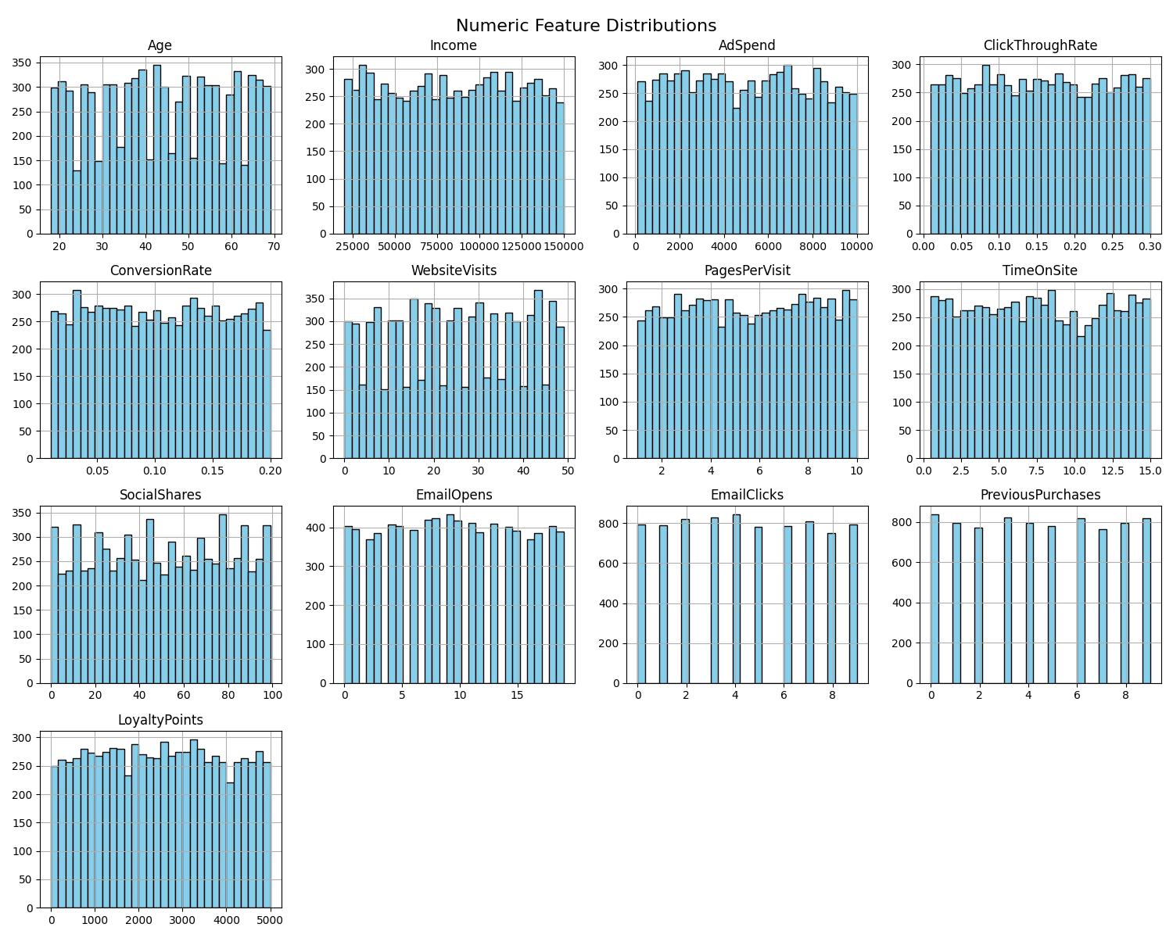
Numeric Feature Distributions
Histogram plots were created for 13 numeric features in the dataset.
Most features such as Income, AdSpend, and SocialShares are right-skewed (few high values).
Features like WebsiteVisits, PagesPerVisit, and TimeOnSite show moderate variation across users.
LoyaltyPoints and PreviousPurchases indicate higher values for customers who converted.
Overall, numeric distributions reveal uneven engagement and spending patterns among customers.

Slide 9
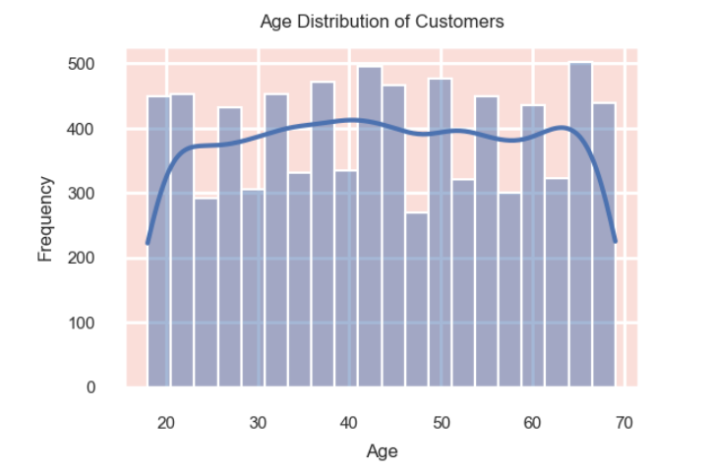
Demographic Analysis
Age Distribution
The age distribution of customers was analyzed using histogram visualization.
Majority of customers fall within the 25–45 age group, showing strong engagement among mid-aged users.
Fewer customers are present in the younger (<25) and older (>55) age ranges.
Indicates that marketing campaigns are most effective for working-age groups.
Useful for designing age-targeted marketing strategies to improve conversions.

Slide 10
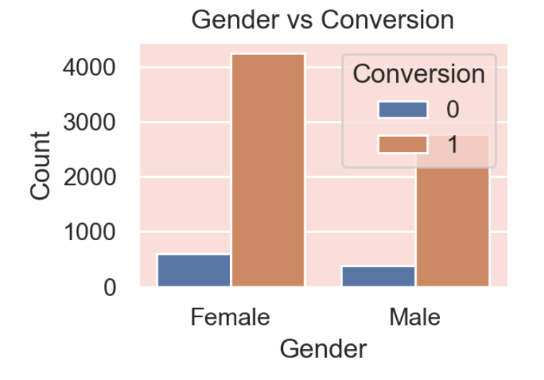
Gender vs Conversion
A bar chart was plotted to compare conversion rates between male and female customers.
Female customers showed a slightly higher conversion rate than males.
Indicates stronger engagement and campaign response among female audiences.
Both genders participated actively, but female users contributed more to overall conversions.
Suggests that gender-based targeting can further improve marketing effectiveness.

Slide 11
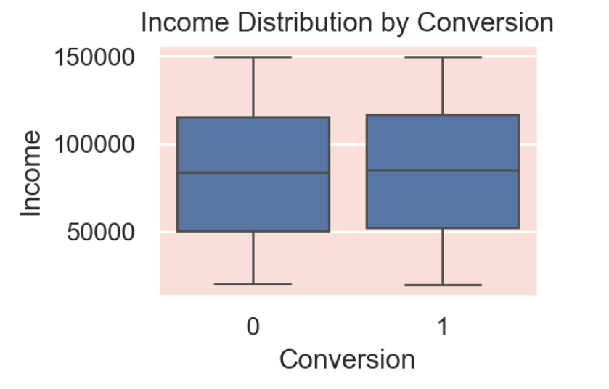
Income vs Conversion
A boxplot was created to analyze the relationship between Income and Conversion status.
Customers with higher income levels tend to show higher conversion rates.
The median income of converted customers is noticeably higher than non-converted ones.
Indicates that purchasing power and financial capacity influence conversion likelihood.
Targeting higher-income groups can help maximize campaign ROI.

Slide 12
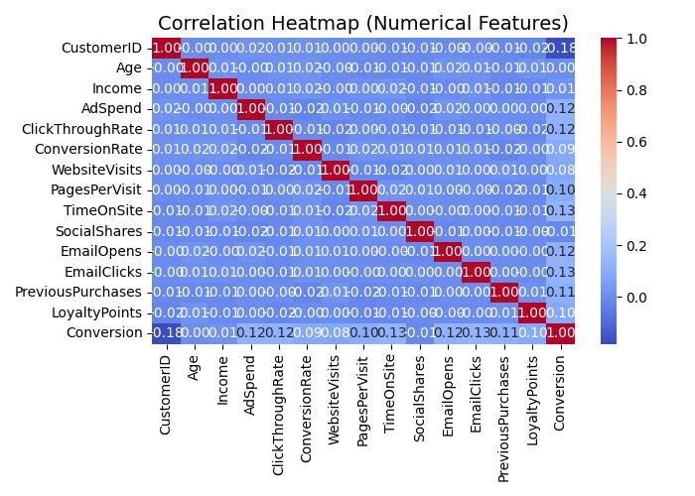
Correlation Heatmap
A correlation heatmap was created to study relationships between numerical features and Conversion.
Strong positive correlations observed for EmailOpens, EmailClicks, LoyaltyPoints, and PreviousPurchases with Conversion.
AdSpend and TimeOnSite also showed moderate positive relationships.
Features like Income and Age had minimal correlation with conversion outcomes.
Heatmap helps identify key predictors for model training and performance improvement.

Slide 13
Pairplot of Key Features vs Conversion
A pairplot was generated to visualize relationships among AdSpend, ClickThroughRate, WebsiteVisits, and TimeOnSite with Conversion.
Positive relationship observed between AdSpend and Conversion — higher spending often leads to better results.
ClickThroughRate and WebsiteVisits show clear separation between converted and non-converted customers.
TimeOnSite increases notably for users who converted, showing stronger engagement.
Overall, the pairplot highlights that higher engagement and ad performance metrics drive more conversions.

Slide 14
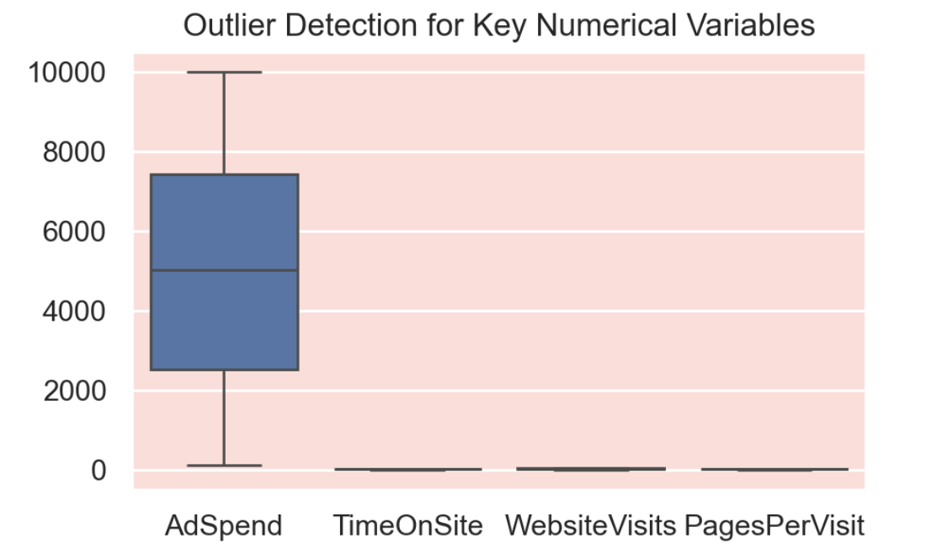
Outlier Detection
Boxplots were used to identify outliers in key numerical variables: AdSpend, TimeOnSite, WebsiteVisits, and PagesPerVisit.
AdSpend showed a few extreme high values, indicating heavy ad investment for certain customers.
TimeOnSite and WebsiteVisits contained mild outliers due to highly active users.
Outliers represent valuable customers with strong engagement or high spending patterns.
These data points were retained as they provide meaningful insights for conversion behavior.

Slide 15
Data Preprocessing
Removed irrelevant columns: CustomerID, AdvertisingPlatform, AdvertisingTool (non-informative).
Checked for missing values and duplicates — none found in the dataset.
checked for Null values -none found inthe dataset.
Applied One-Hot Encoding for categorical variables like Gender, CampaignChannel, and CampaignType.
Scaled numerical features (Income, AdSpend, WebsiteVisits, etc.*) using StandardScaler.
Split data into Training (80%) and Testing (20%) sets using Stratified Sampling to maintain class balance.

Slide 16
Model Selection
Various machine learning algorithms were tested to identify the best predictive model.
Models used for comparison:
Decision Tree
Random Forest
Gradient Boosting
XG Boosting
SVM
Each model was evaluated using metrics such as Accuracy, F1-Score, Precision, Recall, and ROC-AUC.
Gradient Boosting outperformed other models with the highest F1-score and ROC-AUC, making it the final selected model.
Final model achieved strong balance between precision and recall, ideal for conversion prediction tasks.

Slide 17
Experimental Results
Model Result
The trained models were evaluated on the test dataset (20%) using standard performance metrics.
Precision | Recall | F1-Score | ROC-AUC | Accuracy
XGB 92 | 99 | 96 | 82 | 92
GB 92 | 99 | 96 | 82 | 92
SVM 90 | 99 | 94 | 80 | 89
RF 89 | 100 | 94 | 81 | 89
DT 88 | 99 | 94 | 67 | 88

Slide 18
Model Performance: Decision Tree: F1-Score = 0.90 | ROC-AUC = 0.62 Random Forest: F1-Score = 0.94 | ROC-AUC = 0.80 Gradient Boosting: F1-Score = 0.95 | ROC-AUC = 0.82 XGBoost: F1-Score = 0.96, ROC-AUC = 0.85 SVM: F1-Score = 0.92, ROC-AUC = 0.78 XGBoost Classifier achieved the best overall results with strong precision and recall values. Conclusion: XGBoost was selected as the final model due to its superior predictive power and stability.

Slide 19
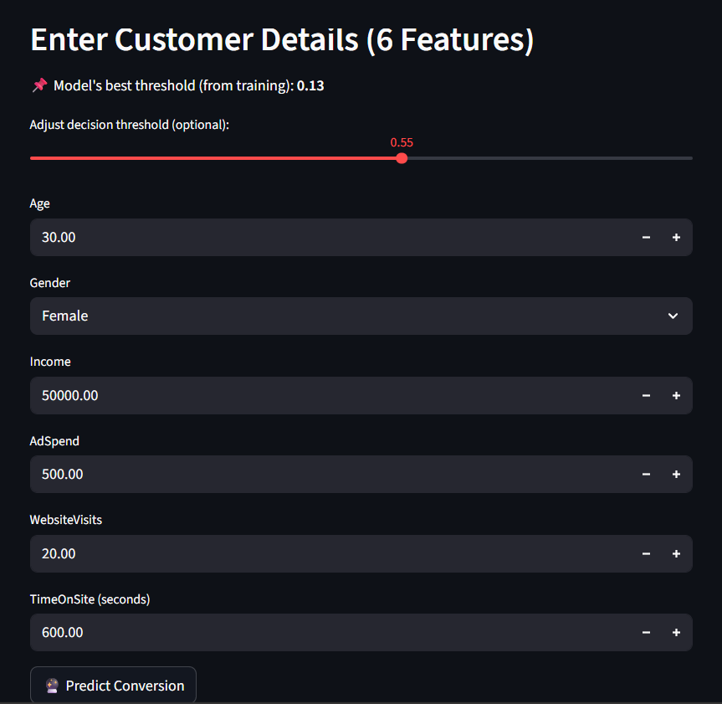
prediction app
Developed a machine learning–based customer conversion prediction system using a tuned XGBoost classifier to identify potential converters accurately.
Selected 6 key customer behavior features (Age, Gender, Income, Ad Spend, Website Visits, Time on Site) to keep the model simple, interpretable, and efficient.
Applied GridSearchCV hyperparameter tuning to improve model performance and reduce false positive conversion predictions.
Addressed class imbalance using scale_pos_weight, ensuring better detection of non-converting customers.
Optimized the decision threshold using F1-score instead of relying on the default 0.5 threshold for more realistic business predictions.
Built an interactive Streamlit web application that allows users to input customer details and receive real-time conversion probability with visual insights.

Slide 20
Conclusion
A machine learning model was developed to accurately predict customer conversions in digital marketing campaigns.After comparison, XGBoost delivered the best performance with high F1-score and ROC-AUC.
🔍 Key Findings:
XGBoost achieved the highest accuracy and F1-score, effectively predicting customer conversions.
Engagement and loyalty features like EmailOpens, WebsiteVisits, and LoyaltyPoints were the most influential factors.
⚠ Limitations:
The dataset showed a class imbalance, slightly affecting recall for minority cases.
External factors such as seasonality or customer mood were not included in the model.
🚀 Future Research
Future work can include real-time data integration and deep learning models for improved accuracy.
Developing an interactive dashboard can further enhance marketing decision support.

Slide 21
THANK YOU

